Slide 1
Lab 03
Merge Sort and Quick Sort

Slide 2
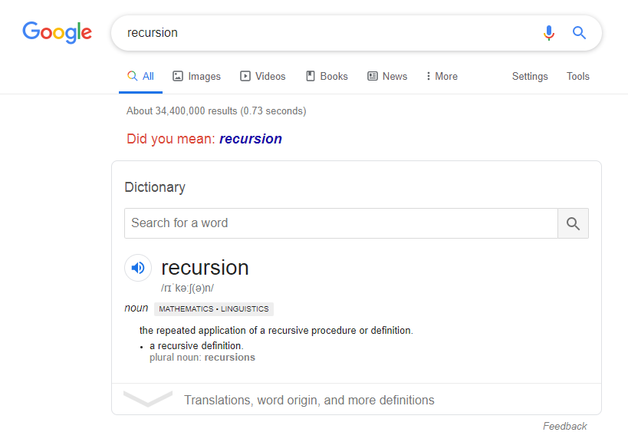
recursion

Slide 3


Slide 4
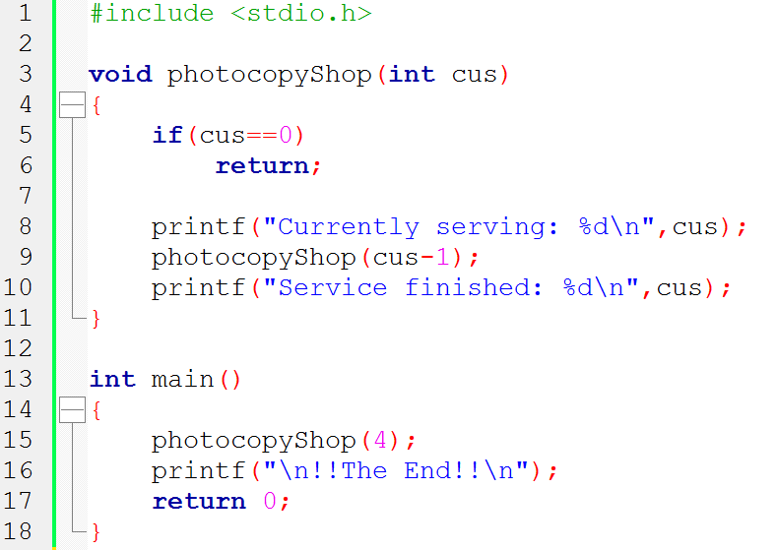
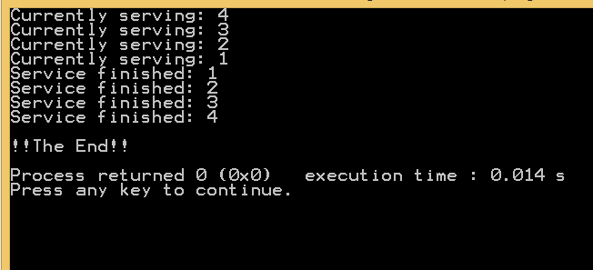

Slide 5
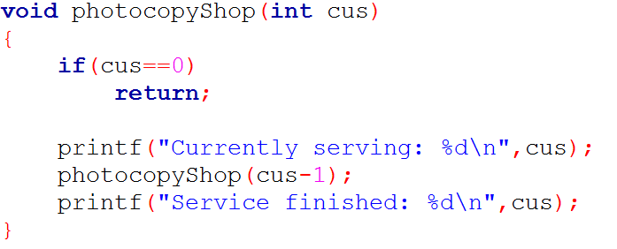
cus = 4
Main photocopyShop(4)
cus = 3
cus = 2
cus = 1

Slide 6
cus = 4
Main photocopyShop(4)
cus = 3
cus = 2
cus = 1

Slide 7
Another Story
Your Mom
1 | 5 | 20 | 100
Your Dad
2 | 10 | 50 | 500 | 1000
You

Slide 8
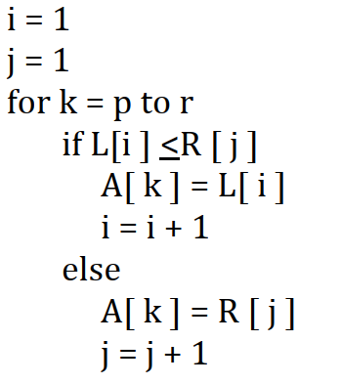
Your Mom
1 | 5 | 20 | 100
R
L
Your Dad
2 | 10 | 50 | 500 | 1000
**
**
A
You

Slide 9
Merge Sort

Slide 10
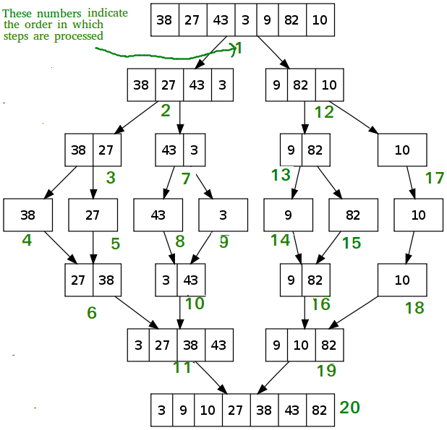
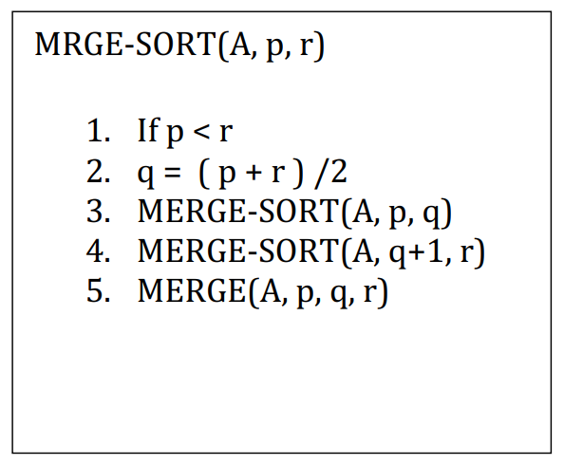
Merge Sort

Slide 11
